Slide 1

G2M Case Study
Virtual Internship, 21-Jan-2023
Vamsi Krishna Oruganti

Slide 2
Problem Statement
XYZ is a private equity firm in US. Due to remarkable growth in the Cab Industry in last few years and multiple key players in the market, it is planning for an investment in Cab industry.
Objective : Provide actionable insights to help XYZ firm in identifying the right company for making investment.

Slide 3
Data Exploration
Given data has 4 csv files and each of them are namely Cab, Customer ID, Transaction ID, City.
Cab_Data.csv
Customer_ID.csv
Transaction_ID.csv
City.csv
Final cab data
Cab_Data – This file includes details of transactions for 2 cab companies and it has 7 columns and 359393 rows of data.
Customer_ID – This file contains ID, Gender, Age and income of the customer and is comprised of 4 Columns and 49172 rows of data.
Transaction ID – This is a mapping table that contains transaction ID, customer ID and payment mode with 3 columns and 440099 samples of data.
City – This file contains a list of 20 US cities with the cities population, and the number of cab users in their respective cities.

Slide 4
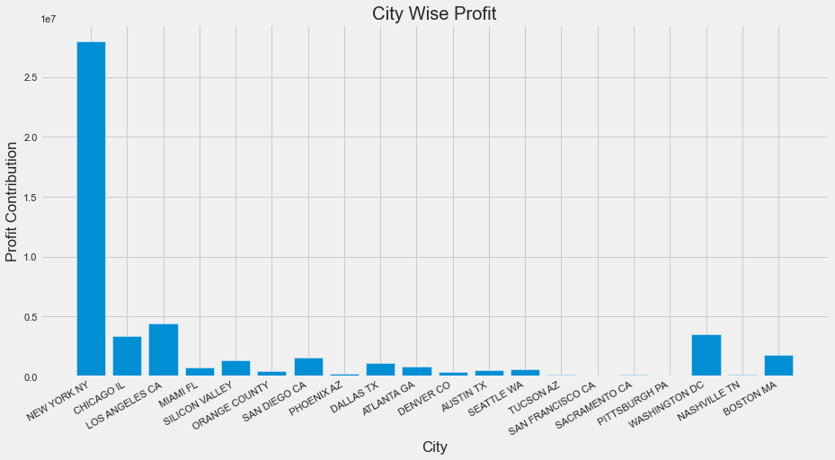
Profit Analysis
Profit Analysis
Here I have given the city wise profit information.
In the x- axis is the city name and y- axis the profit contributed by the city.

Slide 5
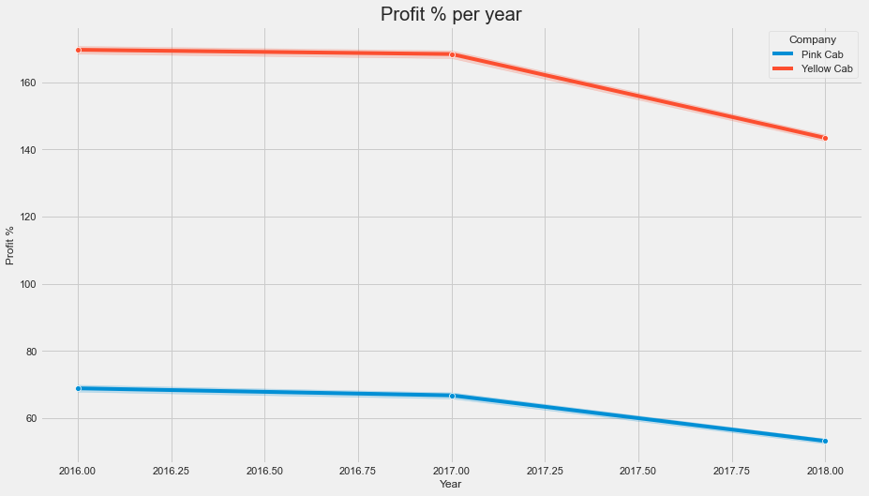
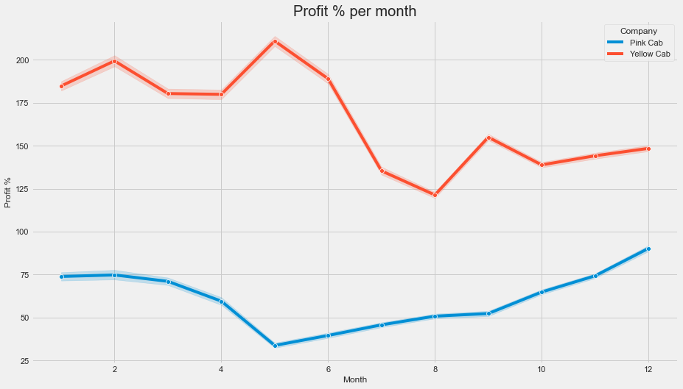
Yearly and monthly Profit Analysis
Yearly profit percentage and monthly profit percentage by both the pink cab and yellow cab is given.

Slide 6
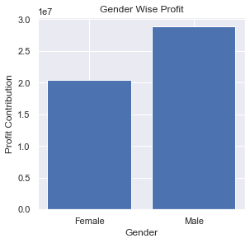
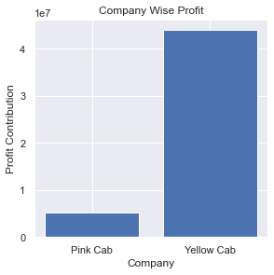
Gender wise Profit and Company wise profit
This is the profit earned by both the companies i.e Pink cab and Yellow cab.
This is the gender wise profit analysis.

Slide 7
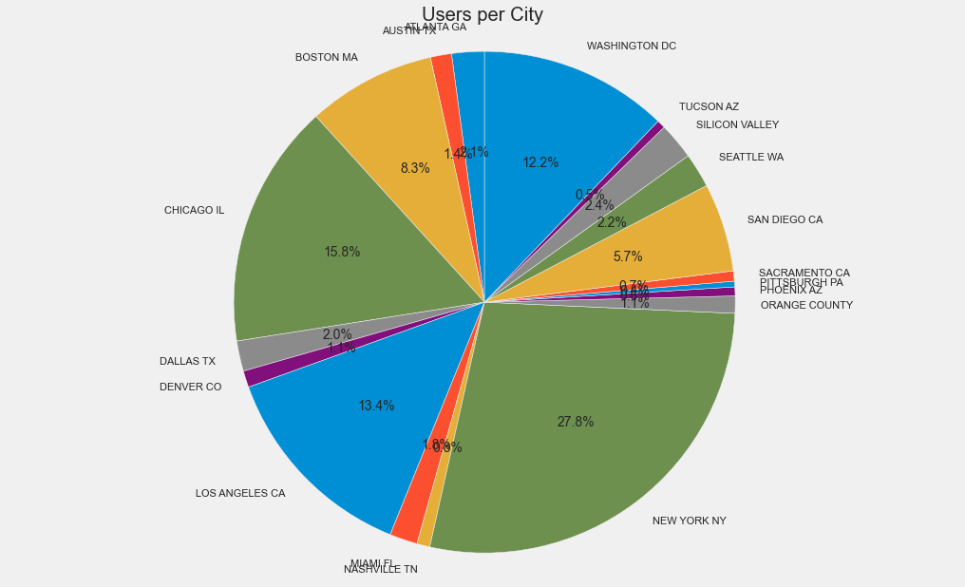
Users per city
This pie chart shows number of Cab users per city. And it consists of both Pink cab and Yellow cab Users per city.
Altogether, the cab users for 20 cities are given in the chart.
New York residents tops the pie with users of 27.8% , followed by Chicago with 15.8% in 2nd place and Los Angeles with 13.4% in the 3rd place.

Slide 8
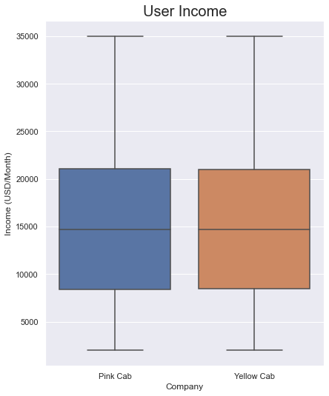
User Income
Clearly the average income of the cab users either Pink cab or Yellow cab is around 15000$.
Here the boxplot is used for this analysis.

Slide 9
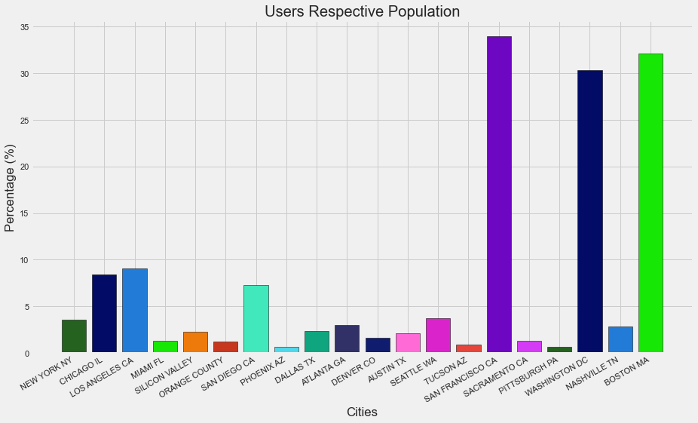
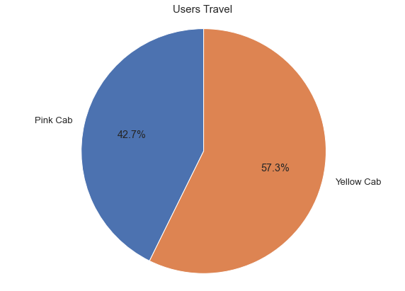
Users population and Users Travel
The Bar graph contains the users population for each city and the overall travel percentage of which cab they uses is given the pie chart.

Slide 10
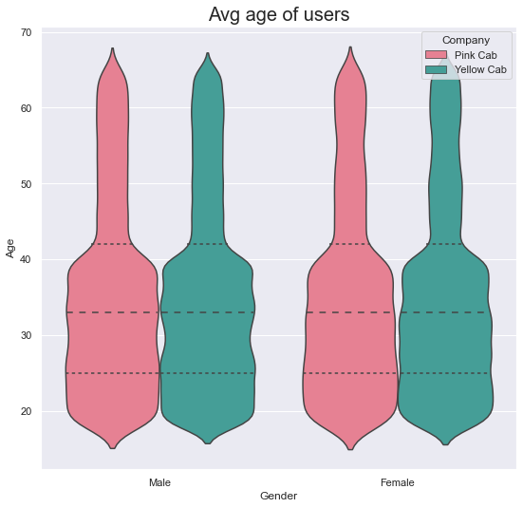
Average age of the users
Average age of the cab users with respect to the gender is given in the Violin plot.
We can see that the average age of the both male and female users is between 30 and 40.

Slide 11
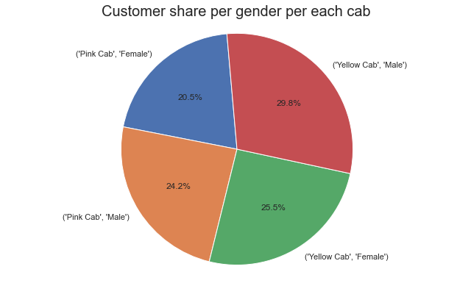
Customer share
This pie chart shows the users share as per gender.
Overall males use cab service more than females.
Both male and females yellow cab more than pink cab.

Slide 12
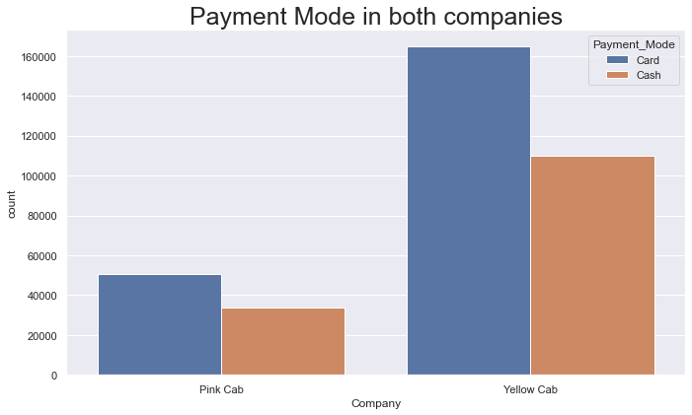
Payment methods
Both yellow cab and pink cab companies receive more card payments to cash payments.
Yellow cab card payments count is greater than 160000, cash payments count around 110000.
Pink cab card payments count is around 50000 and cash payments count is around 30000.

Slide 13
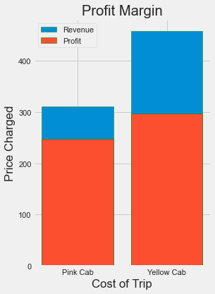
Profit margin
As per the charts pink cab gets around 83.3% profit from the revenue it generates.
Where as Yellow cab gets around 66.67% profits from the revenue it generates.
Overall yellow cabs revenue and profits are more than the pink cab.

Slide 14
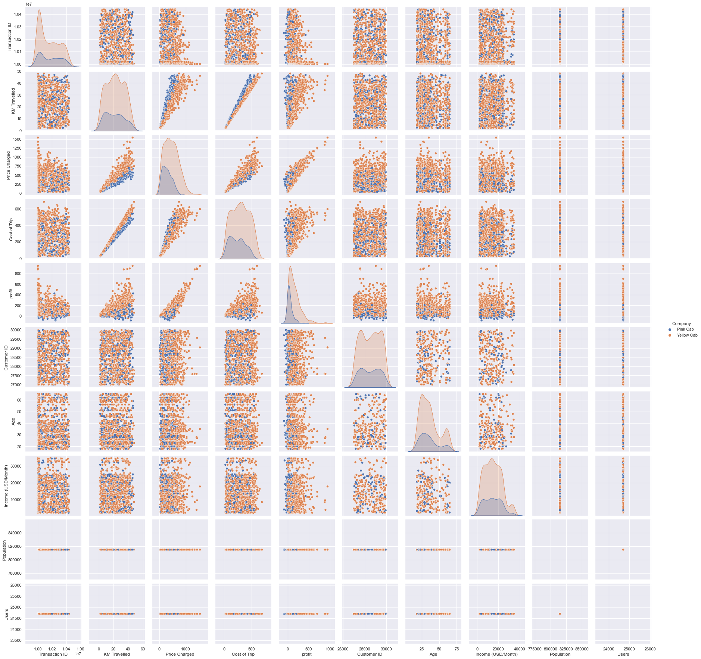
Relation between Variables
This is the relationship between many variables in the data sets.
The variables are Users, Population, Income, Age, Customer ID, Profit, Cost of the trip, Price charged, KM Travelled, Transaction ID.

Slide 15
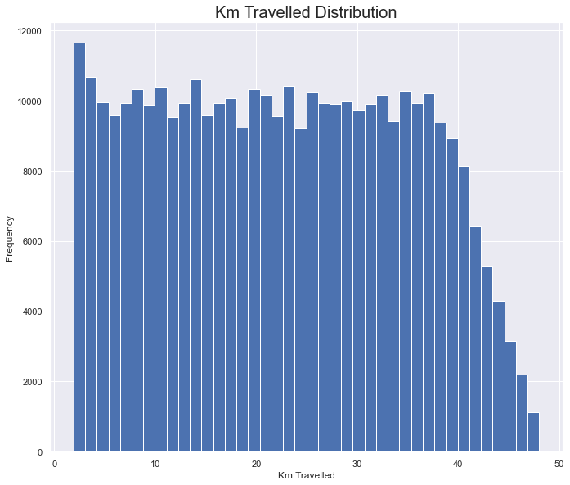
KM Travelled
This bar chart shows how long distances are frequently travelled.
Most of the rides varies from around 2km and approx. 48 km.

Slide 16
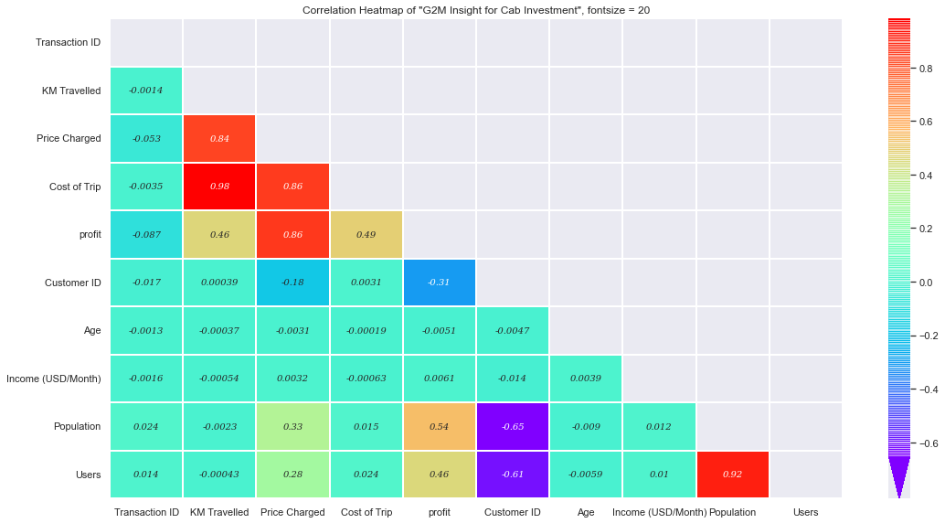
Correlation
This is a correlation between many variables.

Slide 17


Hypothesis
Hypothesis 1: Is there any difference in profit regarding Gender
Null: There is no difference regarding Gender in both cab companies.
Alt: There is a difference regarding Gender in both cab companies.
Conclusion: There is no difference in profit basing on gender
Pink Cab :
Yellow Cab:

Slide 18
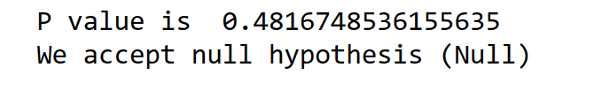

Hypothesis
Hypothesis 2: Is there any difference in Profit regarding Age.
Conclusion: Looks like Yellow Cab company offers discounts for their customers who are older than 60 years old.
Pink Cab :
Yellow Cab:

Slide 19

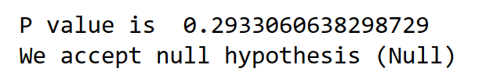
Hypothesis
Hypothesis 3: Is there any difference in Profit regarding Payment mode
Conclusion: There is no difference in profit basing on gender
Pink Cab :
Yellow Cab:

Slide 20
Thank You

